Slide 1
Software Categories
Operating System
controls all machine activities
provides the user interface to the computer
manages resources such as the CPU and memory
Windows, Mac OS, Unix, Linux
Application Programs
generic term for any other kind of software
word processors, missile control systems, games
Most operating systems and many application programs have a graphical user interface (GUI)
One of the better-known features of Java is its extensive set of libraries for GUI design.

Slide 2
Analog vs. Digital Data
Data represent recorded information and/or measurements, usually collected with a goal in mind.
There are two basic ways to store and manage data: Analog
continuous, in direct proportion to the data represented
music on a record album - a needle rides on ridges in the grooves that are directly proportional to the voltages sent to the speaker
Digital
the information is broken down into pieces, and each piece is represented separately
sampling – record discrete values of the analog representation
music on a compact disc - the disc stores numbers representing specific voltage levels sampled at specific times

Slide 3
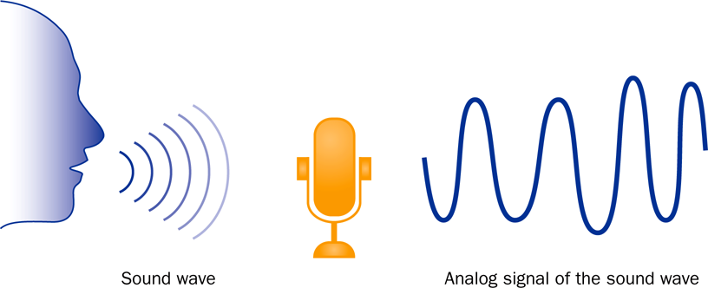
Analog Information

Slide 4
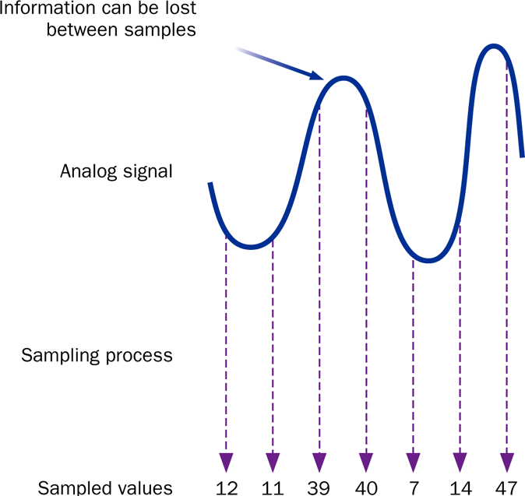
Sampling (part of “Digitization”)

Slide 5
Digital Information
Computers store all information digitally:
numbers
text
graphics and images
audio
video
program instructions
In some way, all information is digitized - broken down into pieces and represented as numbers
Ex: floating-point representations are broken apart into mantissa and exponential components.
-1.525 x 10⁶ ^{mantissa exponent}

Slide 6
Representing Text Digitally
For example, every character is stored as a number, including spaces, digits, and punctuation
Corresponding upper and lower case letters are separate characters
H i , H e a t h e r .
72 105 44 32 72 101 97 116 104 101 114 46

Slide 7
Binary Numbers
Once information has been digitized, it is represented and stored in memory using the binary number system
A single binary digit (0 or 1) is called a bit
Devices that store and move information are cheaper and more reliable if they have to represent only two states
A single bit can represent two possible states, like a light bulb that is either on (1) or off (0)
Permutations of bits are used to store values on a larger scale (ex: decimal).

Slide 8
Bit Permutations
1 bit
2 bits
3 bits
4 bits
0
1
00
01
10
11
000
001
010
011
100
101
110
111
0000
0001
0010
0011
0100
0101
0110
0111
1000
1001
1010
1011
1100
1101
1110
1111
Bit-based storage is quite powerful – each additional bit doubles the number of possible permutations

Slide 9
Bit Permutations
Each permutation can represent a particular item
There are 2^{N} permutations of N bits
Therefore, N bits are needed to represent 2^{N} unique items
1 bit ?
2 bits ?
3 bits ?
4 bits ?
5 bits ?
2¹ = 2 items
How many
items can be
represented by
2² = 4 items
2³ = 8 items
2⁴ = 16 items
2⁵ = 32 items

Slide 10
Quick Check
How many bits would you need to represent each of the 50 United States using a unique permutation of bits?

Slide 11
Quick Check
How many bits would you need to represent each of the 50 United States using a unique permutation of bits?
00000 Alabama
00001 Alaska
00010 Arizona
00011 Arkansas
00100 California 00101 Colorado … 11111 Minnesota
Five bits wouldn't be enough, because 2⁵ is 32.
Six bits would give us 64 permutations, and some wouldn't be used.
In general, for x states you require ceil(log₂(x)) bits.

Slide 12
Outline
Computer Processing
Hardware Components
Networks
The Java Programming Language
Program Development
Object-Oriented Programming

Slide 13
A Computer Specification
Consider the following specification for a personal computer:
Intel Dual-Core i7 processor
4 GB RAM
750 GB Hard Disk
15” High Definition Display with 1366 x 768 resolution
802.11 wireless card

Slide 14
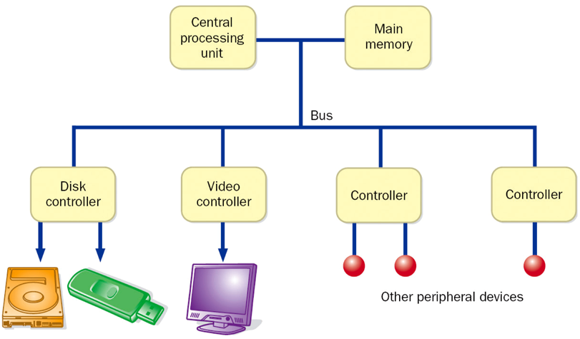
Computer Architecture

Slide 15
Memory
9278
9279
9280
9281
9282
9283
9284
9285
9286
Main memory is divided into many memory locations (or cells)
Each memory cell has a numeric address, which uniquely identifies it

Slide 16
Storing Information
9278
9279
9280
9281
9282
9283
9284
9285
9286
Each memory cell stores a set number of bits (usually 8 bits, or one byte)
10011010
Large values are
stored in consecutive
memory locations

Slide 17
Storage Capacity
Every memory device has a storage capacity, indicating the number of bytes it can hold
Capacities are expressed in various units:
Unit | Symbol | Number of Bytes
kilobyte | KB | 2¹⁰ = 1024
megabyte | MB | 2²⁰ (over one million)
gigabyte | GB | 2³⁰ (over one billion)
terabyte | TB | 2⁴⁰ (over one trillion)
petabyte | PB | 2⁵⁰ (over one quadrillion)

Slide 18
Memory
Main memory is volatile - stored information is lost if the electric power is removed
Secondary memory devices are nonvolatile (information must be maintained if powered off)
Main memory and disks are direct access devices - information can be reached directly
The terms direct access and random access often are used interchangeably
A magnetic tape is a sequential access device since its data is arranged in a linear order - you must get by the intervening data in order to access other information

Slide 19
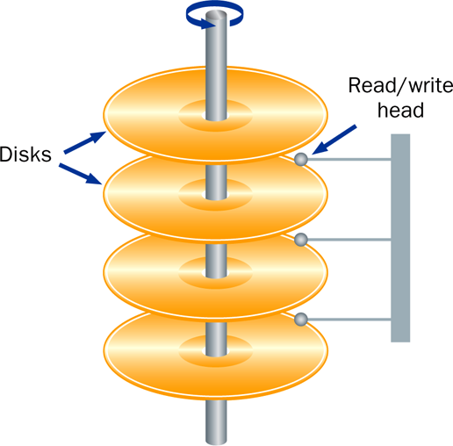
Hard Disk Drive

Slide 20
RAM vs. ROM
RAM - Random Access Memory (direct access)
ROM - Read-Only Memory
The terms RAM and main memory are effectively interchangeable for most machines.
ROM could be a set of memory chips, or a separate device, such as a CD ROM
Both RAM and ROM are random (direct) access devices!
RAM probably should be called Read-Write Memory in practice.

Slide 21
Compact Discs
A CD-ROM is portable read-only memory
A microscopic pit on a CD represents a binary 1 and a smooth area represents a binary 0
A low-intensity laser reflects strongly from a smooth area and weakly from a pit
A CD-Recordable (CD-R) drive can be used to write information to a CD once
The speed of a CD drive indicates how fast (max) it can read and write information to a CD

Slide 22
DVDs
A DVD is the same physical size as a CD, but can store much more information
The format of a DVD stores more bits per square inch
A CD can store 650 MB, while a standard DVD can store 4.7 GB
A double sided DVD can store 9.4 GB
Other advanced techniques can bring the capacity up to 17.0 GB
Like CDs, there are DVD-R discs

Slide 23
Legacy Technology
Legacy technologies are those that have largely been made obsolete by something more powerful or convenient.
Early CPUs and memory are considered legacy.
CD-ROMs and DVDs are largely legacy technologies (i.e. due to the relative convenience of Flash-drives).
HDDs are generally not considered legacy technology, despite the emergence of SSDs.
The storage/cost ratio of SSDs is much higher.
Legacy technologies are potentially not supported by modern hardware, platforms, etc.

Slide 24
The Central Processing Unit
A CPU is on a chip called a microprocessor
It continuously follows the fetch-decode-execute cycle:
Retrieve an instruction from main memory
fetch
execute
decode
Carry out the
instruction
Determine what the
instruction is

Slide 25
The Central Processing Unit
The speed of a CPU is controlled by the system clock
The system clock generates an electronic pulse at regular intervals
The pulses coordinate the activities of the CPU
The speed is usually measured in gigahertz (GHz)

Slide 26
Monitor/ Display Unit
The size of a monitor (15.6") is measured diagonally, like a television screen
A monitor has a certain maximum resolution , indicating the number of picture elements, called pixels, that it can display (such as 1366 by 768)
High resolution (more pixels) produces sharper pictures
Java has a variety of means of displaying graphics to the monitor – some use direct, low-level commands, while other rely on more sophisticated libraries.

Slide 27
Outline
Computer Processing
Hardware Components
Networks
The Java Programming Language
Program Development
Object-Oriented Programming

Slide 28
Networks
A network is two or more computers that are connected so that data and resources can be shared
In the modern world, most computers are connected to some kind of network
Each computer has its own network address, which uniquely identifies it among the others
A file server is a network computer dedicated to storing programs and data that are shared among network users

Slide 29
Network Connections
Each computer in a network could be directly connected to every other computer in the network
These are called point-to-point connections
Adding a computer requires
a new communication line
for each computer already
in the network
This technique is not practical in
most circumstances.

Slide 30
Network Connections
Most networks share a single communication line
Adding a new computer to the network is relatively easy
Network traffic must take
turns using the line, which
introduces delays
Often information is broken
down in parts, called packets,
which are sent to the receiving
machine and then reassembled

Slide 31
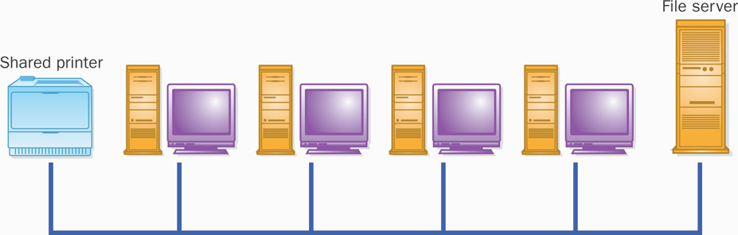
A Computer Network

Slide 32
Local-Area Networks
A Local-Area Network
(LAN) covers a small
distance and a small
number of computers
LAN
A LAN often connects the machines
in a single room or building

Slide 33
Wide-Area Networks
A Wide-Area Network (WAN)
connects two or more LANs,
often over long distances
LAN
LAN

Slide 34
The Internet
The Internet is a WAN which spans the planet
The word Internet comes from the term internetworking
It started as a United States government project, sponsored by the Advanced Research Projects Agency (ARPA)
originally it was called the ARPANET
The Internet grew quickly throughout the 1980s and 90s

Slide 35
TCP/IP
A protocol is a set of rules that determine how things communicate with each other
The software that manages Internet communication follows a suite of protocols called TCP/IP
The Internet Protocol (IP) determines the format of the information as it is transferred
The Transmission Control Protocol (TCP) dictates how messages are reassembled and handles lost information
TCP/IP details are beyond the scope of this course.

Slide 36
IP and Internet Addresses
Each computer on the Internet has a unique IP address, such as:
204.192.116.2
Many computers also have a unique Internet name, which also is referred to as an Internet address:
hector.vt.edu
The first part indicates a particular computer (hector)
The rest is the domain name, indicating the organization (vt.edu)

Slide 37
Domain Names
The last part of a domain name, called a top-level domain (TLD), supposedly indicates the type of organization:
edu educational institution
com commercial entity
org non-profit organization
net network-based organization
Sometimes the suffix
indicates the country:
uk United Kingdom
au Australia
ca Canada
se Sweden
Additional TLDs have
been added, including:
biz, info, tv, name

Slide 38
Domain Names
A domain name can have several parts
Unique domain names mean that multiple sites can have individual computers with the same local name
When used, an Internet address is translated to an IP address by software called the Domain Name System (DNS)
There is no one-to-one correspondence between the sections of an IP address and the sections of an Internet address

Slide 39
The World Wide Web
The World Wide Web allows many different types of information to be accessed using a common interface
A browser is a program which accesses network resources and presents them
Popular browsers: Chrome, Safari, Firefox, Edge
Resources presented include:
text, graphics, video, sound, audio, executable programs
A Web document usually contains links to other Web documents, creating a hypermedia environment
The term Web comes from the fact that information is not organized in a linear fashion

Slide 40
The World Wide Web
Web documents are often defined using the HyperText Markup Language (HTML)
Information on the Web is found using a Uniform Resource Locator (URL):
http://www.google.com
http://www.whitehouse.gov/issues/education
A URL specifies a protocol (ex: http), a domain, and possibly specific documents
http is short for hypertext transfer protocol
You can also use browsers with other protocols, such as file-transfer protocol (ftp)

